Slide 1

KGiSL INSTITUTE OF TECHNOLOGY
COIMBATORE
DEPARTMENT OF computer science & engineering
MINI Project review # 01
FACE MASK DETECTION USING OPEN CV
TEAM MEMBERS:
711720104069 RINEESHA B
711720104070 RISHIKESH R
711720104072 SABARINATHAN V
711720104096 SUSEENDHAR V
Under the guidance of :
MENTOR : Mrs. JANANI S

Slide 2

agenda
Objective of the project work
Existing System
Proposed System
Expected Outcome
References
Timeline

Slide 3
Abstract
The COVID-19 pandemic is causing a worldwide emergency in healthcare. This virus mainly spreads through droplets which emerge from a person infected with coronavirus and poses a risk to others. The risk of transmission is highest in public places. One of the best ways to stay safe from getting infected is wearing a face mask in open territories as indicated by the World Health Organization (WHO). In this project, we propose a method which employs OpenCV to detect face masks on people. A bounding box drawn over the face of the person describes weather the person is wearing a mask or not.
Open CV :
OpenCV is an open-source library which is primarily used for Computer Vision Applications. This contains many functions and algorithms for Motion tracking, Facial recognition, Object Detection, Segmentation and recognition and many other applications. Images and real time video streams can be manipulated to suit different needs using this library.
Tensorflow:
It is an open-source machine learning framework to build and train neural networks. It has a collection of tools, libraries and community resources which helps in easy building of deployment of ML powered applications. This is developed and maintained by Google and was released in 2015.

Slide 4
EXISTING SYSTEM
An existing system for face mask detection using OpenCV typically involves the following steps:
Face detection
Face region extraction
Mask classification
Output visualization
DRAWBACKS OF EXISTING SYSTEM
Limited pose and angle robustness: Existing face mask detection systems using OpenCV may struggle to accurately detect masks when faces are at different angles or in non-frontal poses. The performance may degrade if faces are partially occluded or rotated.
Sensitivity to lighting conditions: Changes in lighting conditions, such as variations in brightness, shadows, or low-light environments, can impact the accuracy of mask detection. Existing systems may struggle to handle such variations.

Slide 5
Literature survey
SNo | Published Year | Paper Title | Authors | Technology
1 | 2021 | Face Mask Detection Using OpenCV | Harish Adusumalli, D. Kalyani ,R.Krishna Sri M. Pratapteja P V R D Prasada Rao | Machine learning,tensor flow and open CV
2 | 2021 | Faster Region-based Convolutional Neural Network for Mask Face Detection | Indah Agustien, SiradjuddinReynaldiArif and Muntasa | Faster Region-based Convolutional Network and Region Proposal Network (RPN)
3 | 2022 | Evaluation of YOLO-X and MobileNetV2 as Face Mask Detection Algorithms | Aaron Berliano Handoko, Vaya Candida Putra,Iwan Setyawan,Darmawan Utomo | Yolo-X and Cnn Network Architecture
4 | 2022 | Accurate Real-Time Face Mask Detection Framework Using YOLOv5 | Nouran Youssry Ahmed Khattab | Yolo Algorithim Preliminaries

Slide 6
PROPOSED SYSTEM
Face detection and alignment: Utilize advanced face detection algorithms, such as the Haar cascade classifier or deep learning-based models like OpenCV's DNN module, to detect and align faces accurately, even in various poses and angles.
Face feature extraction: Extract facial landmarks (e.g., eyes, nose, mouth) using methods like the dlib library or facial landmark detectors available in OpenCV. This step helps in localizing specific regions of interest.
Mask classification: Employ a deep learning model, such as a convolutional neural network (CNN) or a pre-trained model like MobileNet or ResNet, to classify whether a detected face is wearing a mask or not. Train the model on a diverse dataset that includes various mask types, face variations, and lighting conditions to enhance its generalization capability.
ADVANTAGES OF PROPOSED SYSTEM
Improved accuracy: The proposed system leverages advanced face detection and alignment techniques along with deep learning-based classification models, resulting in improved accuracy compared to traditional methods.
Robustness to variations: By training the model on diverse and representative datasets, the system can better handle variations in lighting conditions, face poses, angles, and different mask types, leading to enhanced performance in real-world scenarios.
Real-time performance: By incorporating optimizations like model quantization, pruning, and hardware acceleration, the proposed system can achieve real-time performance, making it suitable for real-time monitoring in various applications, such as airports, hospitals, or public spaces.

Slide 7
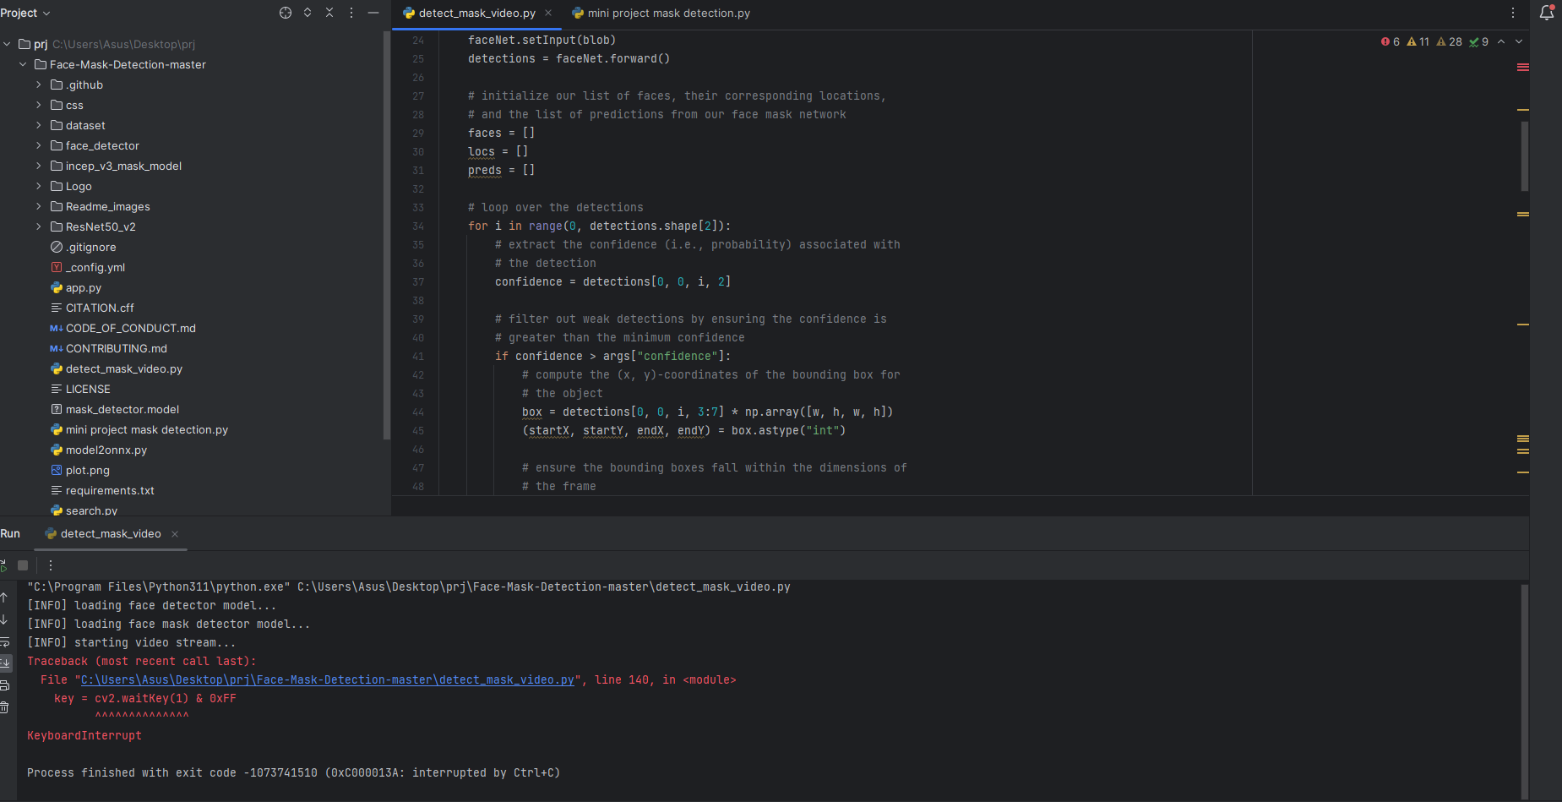
MODULE 1 : SCREENSHOTS

Slide 8


Slide 9
EXPECTED OUTCOME
The expected outcome would be a real-time face mask detection system that can accurately identify and differentiate between faces with and without masks in images or video streams.
The system's performance can vary based on factors such as the quality and diversity of the training data, the effectiveness of the chosen model architecture, and the tuning of hyperparameters during training.

Slide 10
REFERENCE
M. Jiang, X. Fan and H. Yan, "RetinaMask: A Face Mask detector", 2020
C. Kanan and G. Cottrell, "Color-to-Grayscale: Does the Method Matter in Image Recognition?", PLoS ONE, vol. 7, no. 1, pp. e29740, 2012.
D. Meena and R. Sharan, "An approach to face detection and recognition", 2016 International Conference on Recent Advances and Innovations in Engineering (ICRAIE), pp. 1-6, 2016.

Slide 11
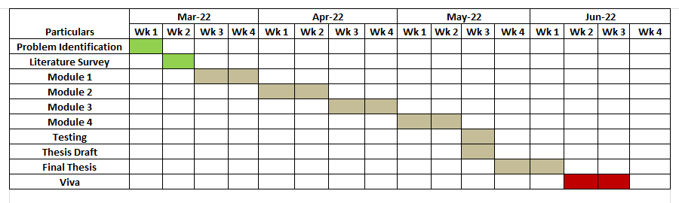
TIMELINE

Slide 12
THANK YOU

